Slide 1
How streaming services have grown
STREAMING THOUGH TIME
Team 4

Slide 2
TABLE OF CONTENTS
01
02
03
04
05
06
Episode 1
Episode 2
Episode 3
Streaming
Industry
Cultura & Economic
Episode 4
Episode 5
Credits
The “Market”
Ethical
Conclusion

Slide 3
Episode 1
01
Streaming revolution

Slide 4








Episode 1 - Streaming revolution
The emerge and evolution of streaming platforms have revolutionized the way we consume entertainment content:
2006
2007
2015
2018
2019
2021
2023

Slide 5
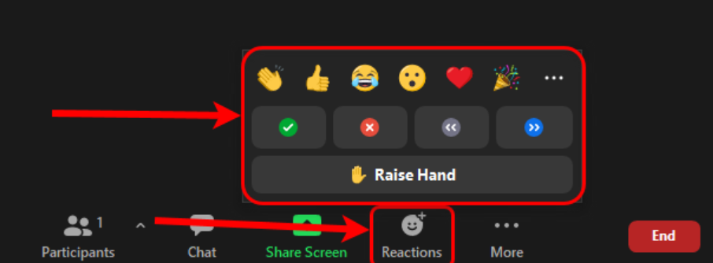
Episode 1 - Streaming revolution
QUICK SURVEY!
How many of you have a subscription to at least 2 streaming platforms?
How many of you still pay for a cable tv package?

Slide 6

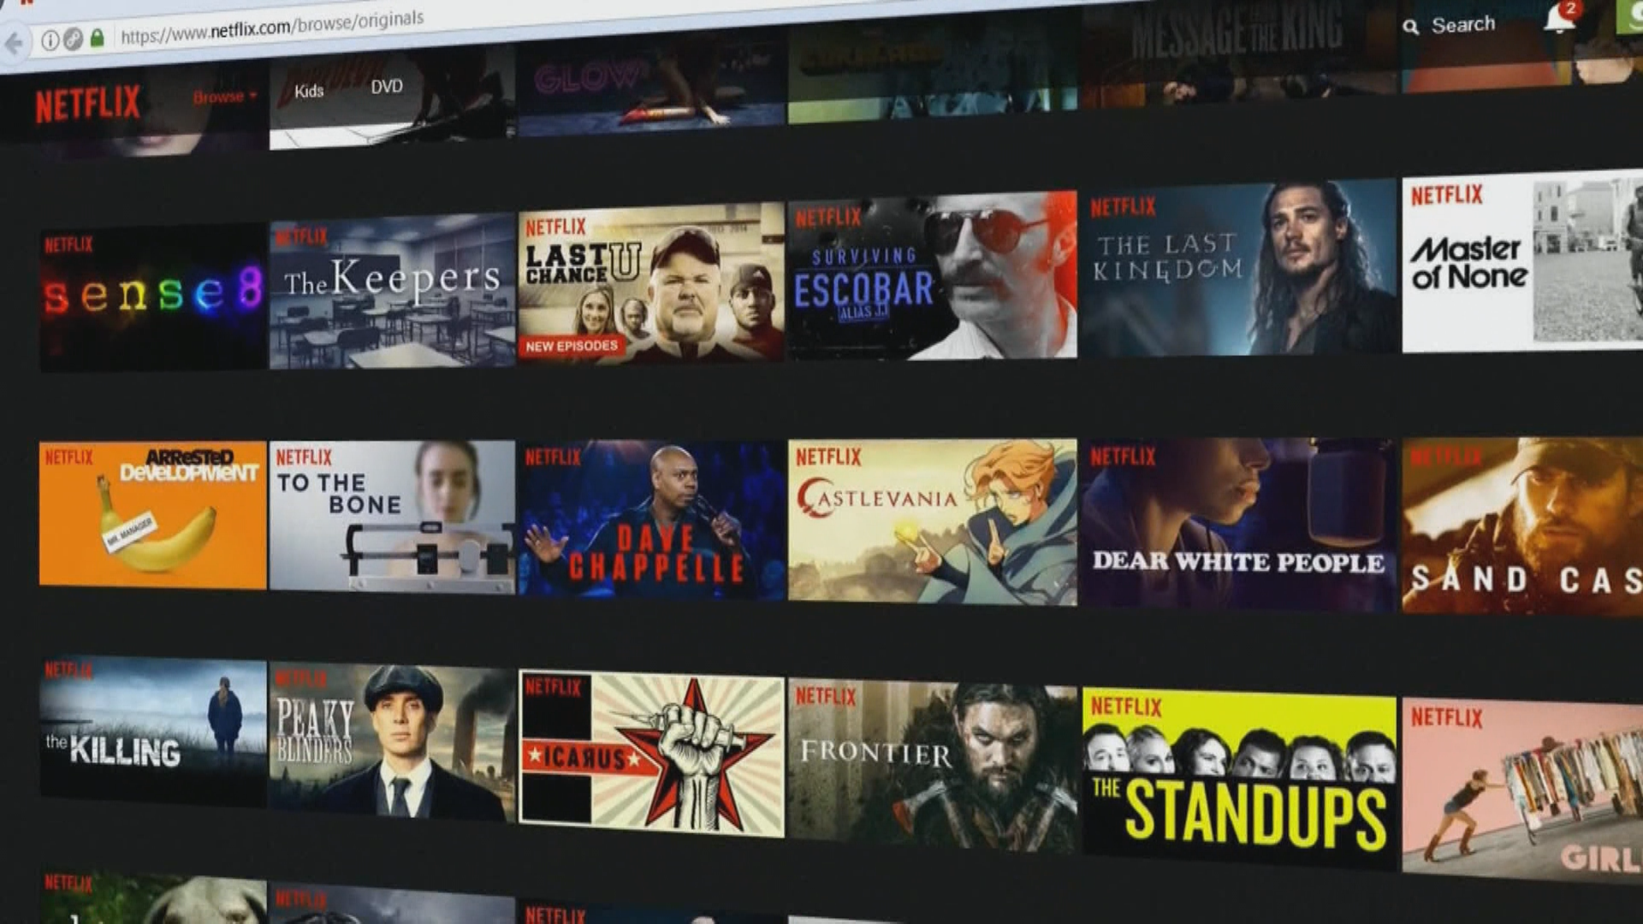
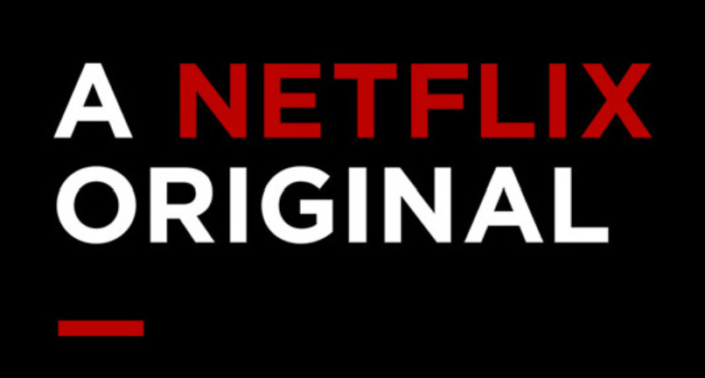



Episode 1 - Streaming revolution
Access
content
variety
Oldies vs. Original
Movies, TV Shows, Sports, News, Gaming and more!
Streaming platforms have democratized access to a vast array of content

Slide 7
Episode 2
02
Industry transformation

Slide 8

ABOUT THE industry
Streaming platforms emerges as disruptors in the entertainment industry, challenging traditional distribution models.
Visualizations illustrate the industry’s growth and its impact on consumer habits in the digital age.

Slide 9

MARKET SEGMENTATION (Movies)
9.4%
42.1%
37.8%
10.7%
Disney
PRime
Last Place
1st Place
Netflix
Hulu
2nd Place
3rd Place

Slide 10
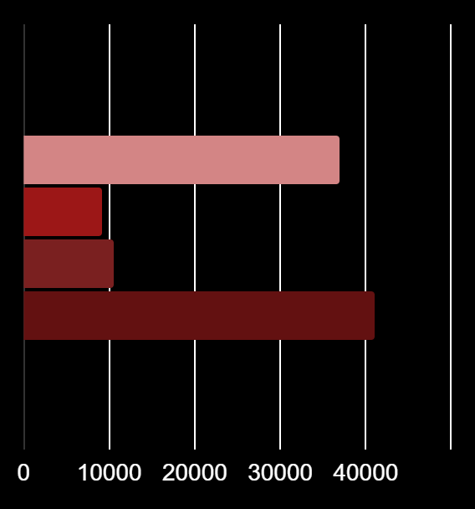
MARKET SHARE (MOVIES)
4,113
922
1,047
3,695
Prime
Since 2006
Disney
Since 2019
Holu
Since 2008
Netlix
Since 1997

Slide 11

MARKET SEGMENTATION (TV Shows)
6.1%
31.7%
34.1%
28.1%
Disney
PRime
Last Place
2nd Place
Netflix
Hulu
1st Place
3rd Place

Slide 12

MARKET SHARE (TV Shows)
1,831
351
1,621
1,971
Prime
Since 2006
Disney
Since 2019
HUlu
Since 2008
Netlix
Since 1997

Slide 13
WHAT SETS US APART?
Movies
Tv shows
Duration
Narrative
Production Quality
Engagement
Flexibility
Audience Loyalty

Slide 14

Dashboard

Slide 15
Episode 3
03
Cultural and economic influence

Slide 16
NETFLIX

Slide 17
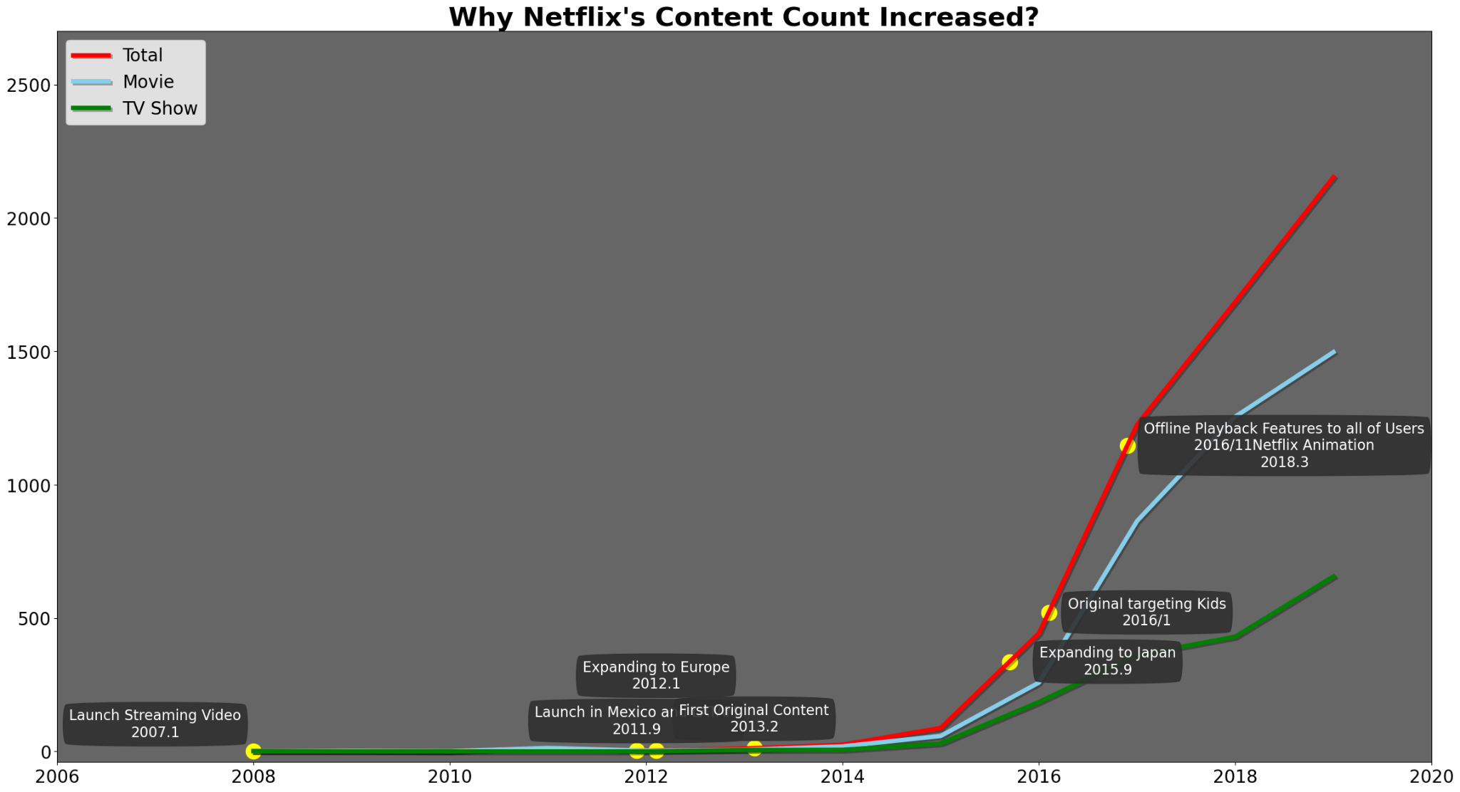
Achievements & Implications
Across the years Netflix has achieved several accomplishments that has made them increase their content from 925 titles in 1998 to the Monster of today’s streaming services.
2007 Launch of streaming video.
2011 Launch in Mexico and Latam.
2012 Expansion to Europe.
2013 First Netflix original.
Expansion to Japan in 2015.

Slide 18
Top 20 Producing Countries across the globe
Who do you think are the top 3 content producers for Netflix?
Is there a particular reason why the second place is so close to the first place?

Slide 19
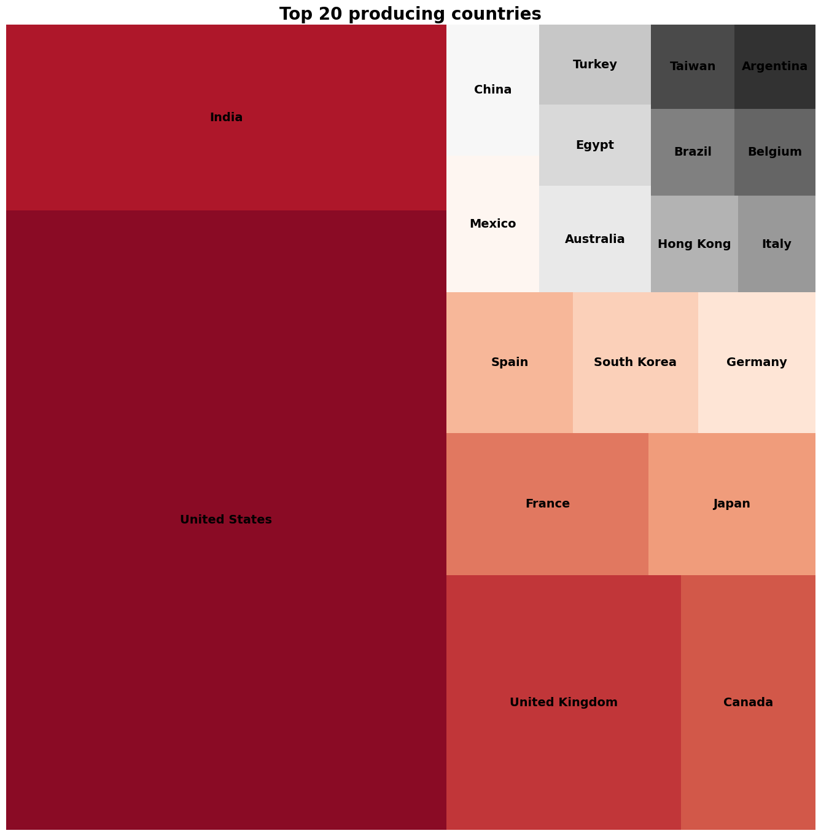
NETFLIX

Slide 20
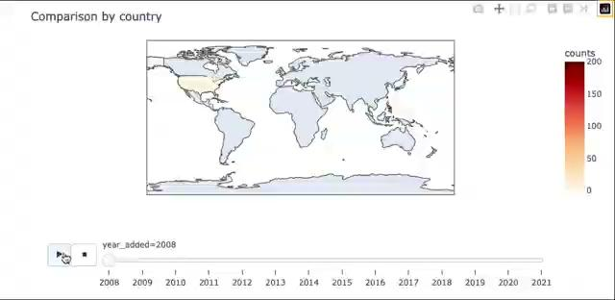
Country Productions throughout the years

Slide 21
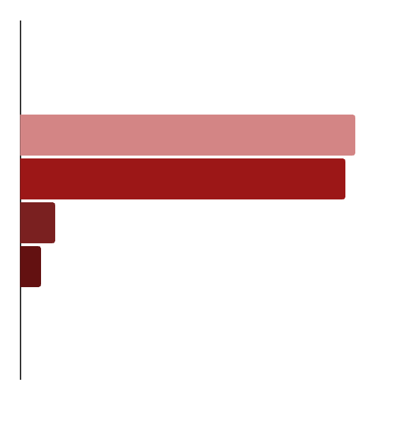
Netflix Movie releases
1,850
1802
193
118
United States
India
United Kingdom
Japan

Slide 22
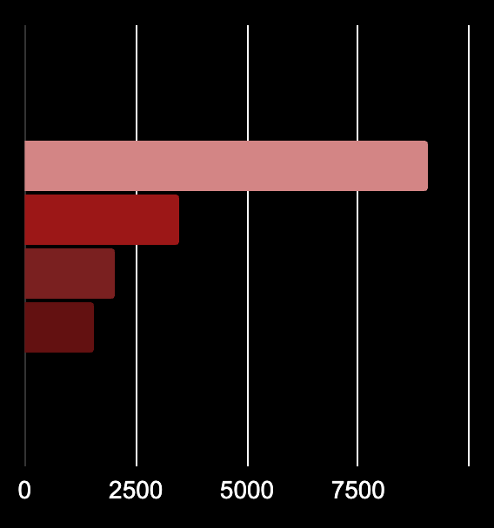
Netflix TV Show releases
905
348
204
157
United States
India
United Kingdom
Japan

Slide 23
Episode 4
04
Market Dynamics and Competition

Slide 24
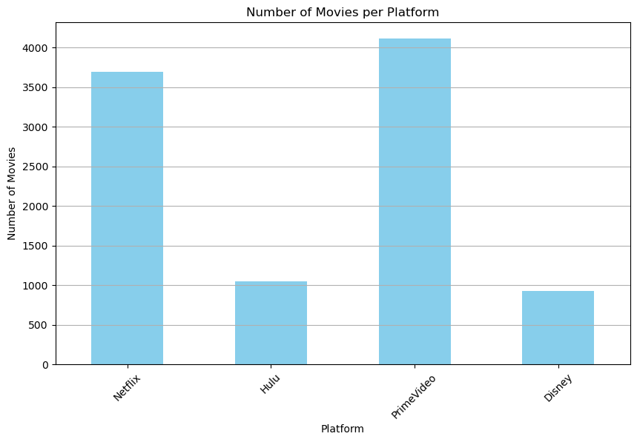
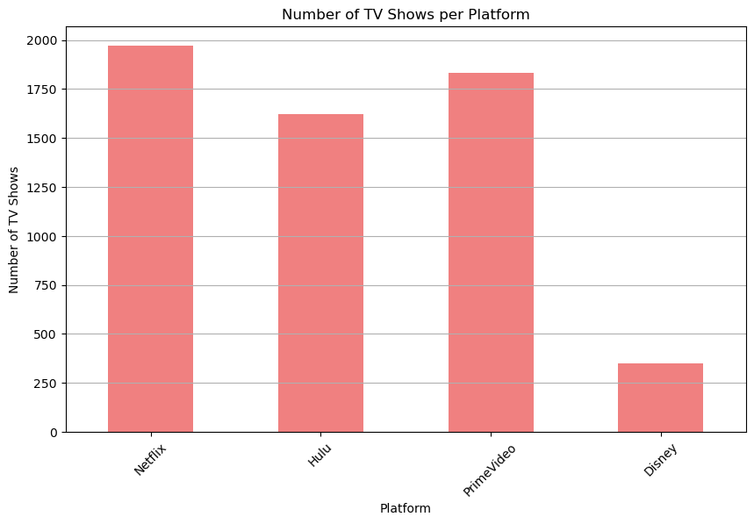
MARKET DYNAMICS AND COMPETITION
Nowadays in a high competitive market where are many products being offered to customers, streaming platforms have to focus on:
Identification of growth rates
Impact of major event
Investment in original content
Identify content of other platforms
Strategies per target demographics

Slide 25
Episode 5
05
Ethical Considerations and Future Trends

Slide 26

Ethical Considerations
Streaming platforms have access to an enormous amount of client information, including behavioral advertising and access and device information.
Platforms need to keep their security to the highest standard to protect the users information.
Users should always check their privacy and data settings on all streaming platforms to reduce the amount of personal information they give access to.

Slide 27



Future Trends
Will streaming services continue to grow and become the norm in the future?
Will other media such as paid TV and cinemas continue to decline as many newer platforms are created?
How much will streaming platforms adding member number and IP address
limitations affect how much the consumer is willing to pay for the service?

Slide 28
credits
00
Conclusion

Slide 29



Credits
Streaming platforms have changed the way we consume media as well as taken control of a huge portion of the media market. The accessibility these platforms provide is unparalleled.
Netflix and Prime remain the highest movie producing platforms, but newer platforms like Disney+ are starting to catch up.
Hulu decided to focus on TV series instead of movies, being responsible for almost 30% of TV series produced.
India is by far the second most producing country after the United States, especially in the movie sector.

Slide 30

The End

